Slide 1
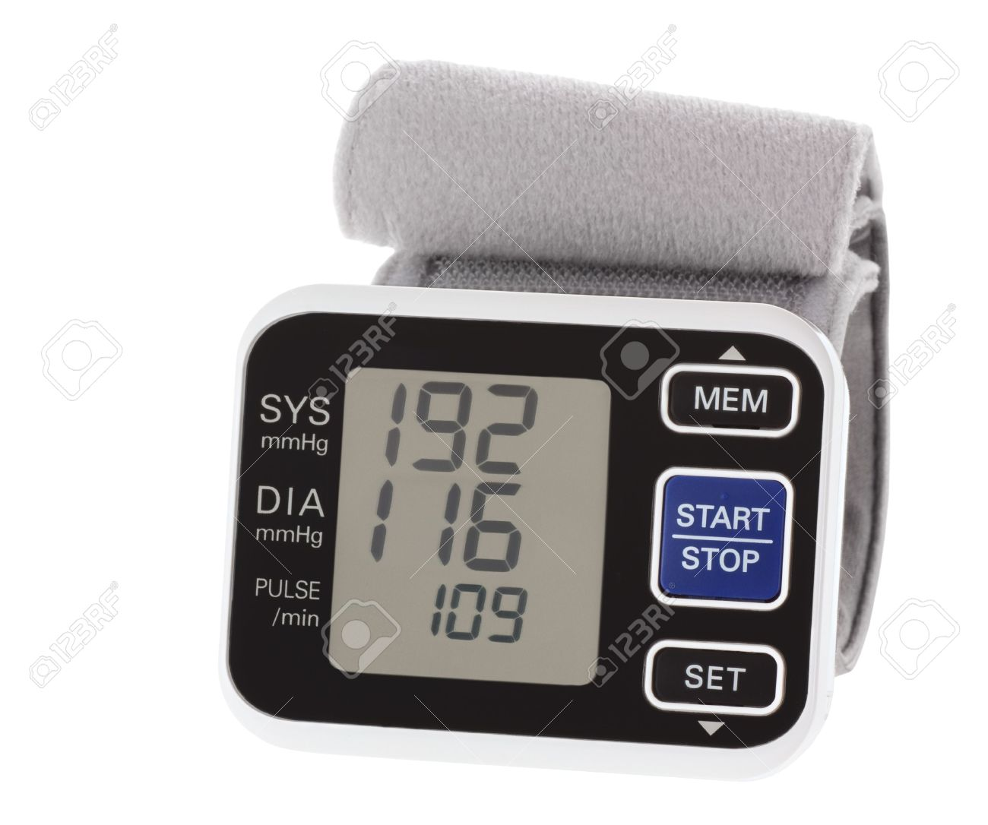
Fundamentals of Nursing (1st Stage)
Pulse & Blood pressure
Lecture 4
By
Assistant. Lecturer. Khadija Mohammed Jassim
Fundamentals of Nursing Department
College of Nursing
University of Basrah
University of Basrah –College of Nursing – Fundamentals of Nursing Department

Slide 2
Vital Signs
Vital signs are a person’s temperature, pulse, respiration, and blood pressure.
Pain, often included as the fifth vital sign.
Pulse oximetry, the noninvasive measurement of arterial oxyhemoglobin saturation, is also often included with the measurement of vital signs in hospitalized patients.
The health status of a person is reflected in these indicators of body functions, regulated through homeostatic mechanisms, and falling within certain normal ranges. A change in vital signs might indicate a change in health.
University of Basrah –College of Nursing– Fundamentals of Nursing Department
2

Slide 3
Pulse
pulse is a throbbing sensation that can be palpated over a peripheral artery, such as the radial artery or the carotid artery.
University of Basrah –College of Nursing– Fundamentals of Nursing Department
3

Slide 4
Cardiac output
Cardiac output is the volume of blood pumped into the arteries by the heart and equals the result of the stroke volume (SV) times the heart rate (HR) per minute.
For example:
65 mL * 70 beats per minute= 4.55 L per minute.
When an adult is resting, the heart pumps about 5 liters of blood each minute.
University of Basrah –College of Nursing– Fundamentals of Nursing Department
4

Slide 5
peripheral pulse
Peripheral pulses are palpable when blood is ejected as the left ventricle contracts and pumps blood into the vascular system.
As the heart contracts to eject blood into an already full aorta, smooth muscle in the arteries expands to compensate for the increase in pressure of the blood.
Characteristics of the peripheral pulse, including :
Rate.
Quality (strong or weak).
Rhythm , and volume of blood ejected with each heartbeat (also referred to as stroke volume).
University of Basrah –College of Nursing– Fundamentals of Nursing Department
5

Slide 6
Factors Affecting the Pulse
The rate of the pulse is expressed in beats per minute (beats/min). A pulse rate varies according to a number of factors. The nurse should consider each of the following factors when assessing a client’s pulse:
Age & gender.
physical activity.
Fever & stress.
Disease .
Medications.
University of Basrah –College of Nursing– Fundamentals of Nursing Department
6

Slide 7
Normal Pulse Rate
The normal pulse rate for adolescents and adults ranges from (60 to100beats/min).
The pulse rate increases and decreases in response to a variety of physiologic mechanisms.
It might also be altered by any of the factors. Normal pulse rates change across the lifespan, gradually diminishing from birth to adulthood.
University of Basrah –College of Nursing– Fundamentals of Nursing Department
7

Slide 8
As the heart rate increases, cardiac output usually also increases. However, Tachycardia, a rapid heart rate, decreases cardiac filling time, which, in turn, decreases stroke volume and cardiac output. An adult has tachycardia when the pulse rate is (100 to 180 beats/min).
Bradycardia is a pulse rate below (60 beats/min) in an adult. The pulse rate is normally slower during sleep in men and in people who are thin. It slows during hypothermia as metabolic processes decrease. The pulse also tends to become slower with aging.
University of Basrah –College of Nursing– Fundamentals of Nursing Department
8

Slide 9
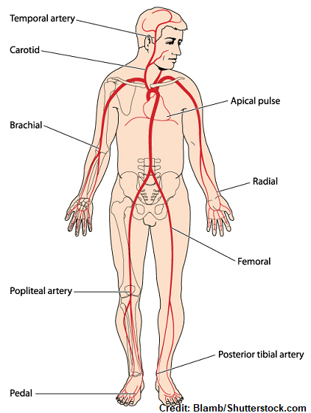
Pulse Sites
Temporal .
Carotid.
Apical.
Brachial.
Radial.
Ulnar .
Femoral.
Popliteal.
Posterior tibial.
Dorsalis pedis.
University of Basrah –College of Nursing– Fundamentals of Nursing Department
9

Slide 10
Assessing the Pulse
A pulse is commonly assessed by palpation (feeling) or auscultation (hearing). The middle three fingertips are used for palpating all pulse sites except the apex of the heart. A stethoscope is used for assessing apical pulses.
A pulse is normally palpated by applying moderate pressure with the three middle fingers of the hand.
Before the nurse assesses the resting pulse, the client should assume a comfortable position. The nurse should also be aware of the following:
University of Basrah –College of Nursing– Fundamentals of Nursing Department
10

Slide 11
Any medication that could affect the heart rate.
Whether the client has been physically active. If so, wait (10 to
15 minutes )until the client has rested and the pulse has slowed to its usual rate.
3. Any baseline data about the normal heart rate for the client. For
example, a physically fit athlete may have a resting heart rate below
60 beats/min.
4. Whether the client should assume a particular position (e.g., sitting).
5. In some clients, the rate changes with the position because
of changes in blood flow volume and autonomic nervous system
activity.
University of Basrah –College of Nursing– Fundamentals of Nursing Department
11

Slide 12
Assessing The Apical Pulse
Apical pulse measurement is also the preferred method of pulse assessment for infants and children less than 2 years of age .
The contraction of the heart can be heard in the space between the fifth and the sixth ribs, about 8 cm (3 inches) to the left of the median line and slightly below the nipple.
University of Basrah –College of Nursing– Fundamentals of Nursing Department
12

Slide 13
University of Basrah –College of Nursing– Fundamentals of Nursing Department
13

Slide 14
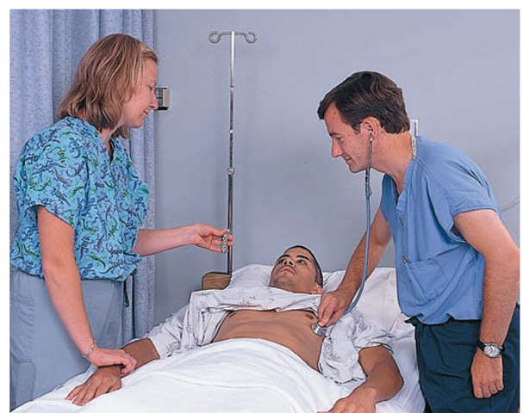
Assessing The Apical-radial Pulse
A difference between the apical and radial pulse rates is called the pulse deficit and
indicates that all of the heartbeats are not reaching the peripheral arteries or are too weak to be palpated.
University of Basrah –College of Nursing– Fundamentals of Nursing Department
14

Slide 15
Blood Pressure
Blood pressure refers to the force of the moving blood against arterial walls.
Maximum blood pressure is exerted on the walls of arteries when the left ventricle of the heart contracts and pushes blood through the aortic valve into the aorta at the beginning of systole.
Blood pressure is measured in millimeters of mercury (mm Hg)
University of Basrah –College of Nursing– Fundamentals of Nursing Department
15

Slide 16
The highest pressure, created during ventricular contraction, is the systolic pressure.
When the heart rests between beats during ventricular diastole, the pressure drops. The lowest pressure present on arterial walls at this time is the diastolic pressure.
The difference between the systolic and diastolic pressures is called the pulse pressure.
University of Basrah –College of Nursing– Fundamentals of Nursing Department
16

Slide 17
Age:
Circadian rhythm
GenderFood intake:
Exercise:
Factors Affecting Blood Pressure
Age.
Gender.
Circadian rhythm.
Exercise .
Weight.
Food intake.
Emotional status.
Body position.
Race.
Medications .
University of Basrah –College of Nursing– Fundamentals of Nursing Department
17

Slide 18
Categories For Blood
Pressure Levels
Blood Pressure Classifications | Systolic BP | Diastolic BP
Normal | <120 mmHg | <80 mmHg
Prehypertension | 120–139 mmHg | 80-89 mmHg
High blood pressure
Stage 1 | 140-159 mmHg | 90-99 mmHg
Stage 2 | ≥ 160 mmHg | ≥ 100 mmHg
University of Basrah –College of Nursing– Fundamentals of Nursing Department
18

Slide 19
Hypertension is made when the systolic pressure is 140 mm Hg or higher or the diastolic pressure is 90 mm Hg or higher.
Hypotension is below-normal blood pressure. A consistently low blood pressure (e.g., a systolic reading of 90–115 mm Hg).
Orthostatic hypotension (postural hypotension) is a decrease in systolic blood pressure of 20 mm Hg or a decrease in diastolic blood pressure of 10 mm Hg within 3 minutes of standing when compared with blood pressure from the sitting or supine position.
University of Basrah –College of Nursing– Fundamentals of Nursing Department
19

Slide 20
It results from an inadequate physiologic response to postural (positional) changes in blood pressure. Orthostatic hypotension may be acute or chronic, as well as symptomatic or asymptomatic .
It is associated with:
Dizziness .
Lightheadedness.
Blurred vision.
Weakness .
Fatigue.
Nausea.
Palpitations.
Headache.
University of Basrah –College of Nursing– Fundamentals of Nursing Department
20

Slide 21
University of Basrah –College of Nursing– Fundamentals of Nursing Department
21

